Slide 1




You are to watch a video clip about the Peasant’s revolt. Whilst watching, you are to write down why the Peasant’s revolted, what the tax was called that made them unhappy, the names of the people involved and where they were from.
Peasants revolt

Slide 2

The Big Picture
Last lesson | This lesson | Next lesson
Was the Black Death a complete disaster? | Why did the Peasant’s revolt? | What was the legacy of the peasant’s revolt

Slide 3

Why did the Peasants’ Revolt?
By the end of the lesson, you will understand…
Why the peasants revolt
What happened during the revolt
Which reason was the most important in making the peasants revolt
By the end of the lesson, you will be able to...
Explain why the peasants revolted
Examine what happened before the revolt
Evaluate which reason was the most important in making the peasants revolt
Write down the underlined words in bold!

Slide 4

Input one
The Story of the Peasants Revolt
1. Most people were peasants. They did not like working hard for small amounts of money. | 2. After the Black Death things got better. Most people had died so they had to pay those who were left more money. | 3. But employers wanted to pay peasants the same as before the Black Death. They also wanted them to be taxed.
6. In 1381 a large group of peasants went to London to talk to the King Richard II. | 5. Peasants no longer wanted to be slaves, so they decided to go and talk to the new King and ask for things to be fairer. | 4. Peasants were fed up working hard for little money. They were annoyed that the rich had lovely things and they didn’t.
LO - Explain why the peasants revolted

Slide 5
7. King Richard II did not want to look weak by letting the peasants have what they wanted. | 8. The leader of the peasants Wat Tyler went to talk to the King Richard but he was killed. | 9. All leaders of the Peasants Revolt were hung, drawn and quartered.
12. So peasants were no longer slaves. | 11. The rich people were worried about being mean to the peasants in case they hurt them. | 10. The Peasants went back to being slaves.
BUT WHY DID THE PEASANTS REVOLT????
LO - Explain why the peasants revolted

Slide 6
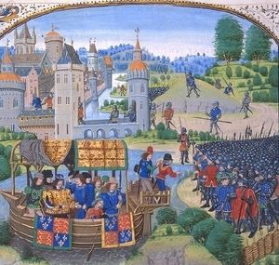
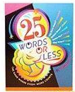
Activity one
Why did the Peasants revolt? You are to explain in 25 words or less why they revolted.
LO - Explain why the peasants revolted

Slide 7

Review one
What was your explanation?
LO - Explain why the peasants revolted

Slide 8
Why did the Peasants’ Revolt?
By the end of the lesson, you will understand…
Why the peasants revolt
What happened during the revolt
Which reason was the most important in making the peasants revolt
By the end of the lesson, you will be able to...
Explain why the peasants revolted
Examine what happened before the revolt
Evaluate which reason was the most important in making the peasants revolt

Slide 9
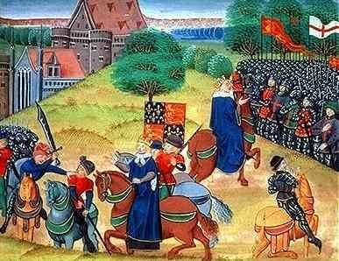

Slide 10

What happened before the Revolt?
Although the Black Death had brought a better standard of living for some peasants, they still led miserable lives.
Peasants hated the Statute of Labourers. This was a law arranged by the rich to keep the peasants’ wages low and kept them tied to one lord. Some peasants would move from village to village looking for the highest wage. If peasants were caught they would be returned to their own village where they would be punished. Peasants became angry and bitter. In 1360, poorer priests began to complain about rich leaders of the church.
LO: Examine what happened before the revolt

Slide 11
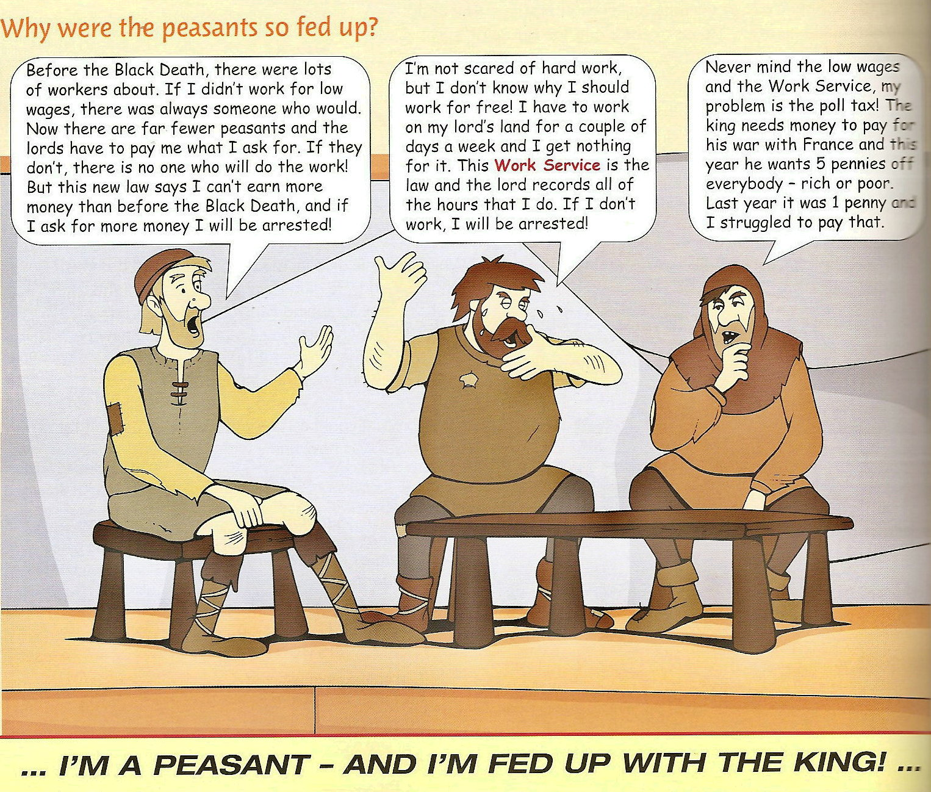
LO: Examine what happened before the revolt

Slide 12

John Wyclif was the first to say this.
John Ball a priest in Kent carried on this message.
1375: King Edward III ran out of money to pay for the war with France.
1377: A Poll tax was introduced. Everyone over 15 years had to pay 5 pence for the war. This was an unpopular tax because the poor was paying the same as the rich.
1381: Tax collectors began rounding up all those who did not pay.
In the same year 3 tax collectors were murdered in Essex. A revolt began.
LO: Examine what happened before the revolt

Slide 13
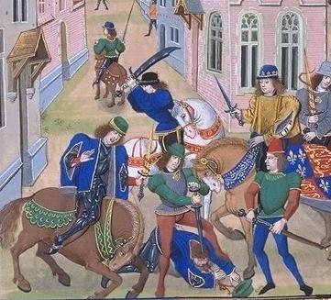
Rioting spread from Essex to Kent. The rebels were under the command of Wat Tyler. By 12th June the rebels had reached London. John Ball gave a number of rousing speeches.
LO: Examine what happened before the revolt

Slide 14

Activity two
You are going to examine what happened before the Peasant’s revolt. Within your examination you will need to answer he following questions:
1. What was the Statute of Labourers?
2. Why were so many peasants fed up with King Richard?
LO: Examine what happened before the revolt

Slide 15
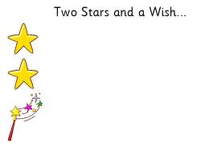
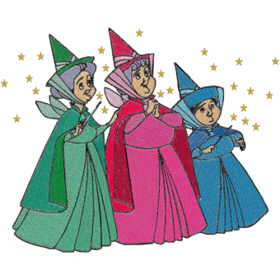
Review two
You are to swap books with the person next to you and give them 2 stars (good points) and a wish (an area for improvement).
LO: Examine what happened before the revolt

Slide 16
Why did the Peasants’ Revolt?
By the end of the lesson, you will understand…
Why the peasants revolt
What happened during the revolt
Which reason was the most important in making the peasants revolt
By the end of the lesson, you will be able to...
Explain why the peasants revolted
Examine what happened before the revolt
Evaluate which reason was the most important in making the peasants revolt

Slide 17

Activity three
Which reason do you think was the most important for making the peasant’s revolt? You are to evaluate which reason you think was the most important with reasons why.
Evaluate which reason was the most important in making the peasants revolt

Slide 18
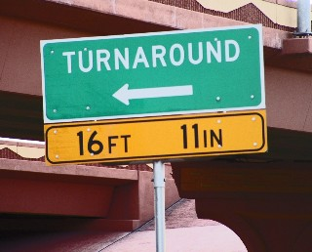
Review three
You are to turn to the person behind and share your evaluation with them.
Evaluate which reason was the most important in making the peasants revolt

Slide 19
Why did the Peasants’ Revolt?
By the end of the lesson, you will understand…
Why the peasants revolt
What happened during the revolt
Which reason was the most important in making the peasants revolt
By the end of the lesson, you will be able to...
Explain why the peasants revolted
Examine what happened before the revolt
Evaluate which reason was the most important in making the peasants revolt

Slide 20


You are a secret spy for the King. You have been sent on a secret mission to find out what the peasants are doing. You need to send a spy report back suggesting what he should do. Options include meet with the leaders, arrest the leaders or introduce changes to deal with the unrest.

Slide 21

The Big Picture
Last lesson | This lesson | Next lesson
Was the Black Death a complete disaster? | Why did the Peasant’s revolt? | What was the legacy of the peasant’s revolt

Slide 22

Consolidation Phase
Thumbs up/Thumbs down
By the end of the lesson, you will understand…
Why the peasants revolt
What happened during the revolt
Which reason was the most important in making the peasants revolt
By the end of the lesson, you will be able to...
Explain why the peasants revolted
Examine what happened before the revolt
Evaluate which reason was the most important in making the peasants revolt

